Slide 1
GovState
transfer
EXPERIENCE

Slide 2
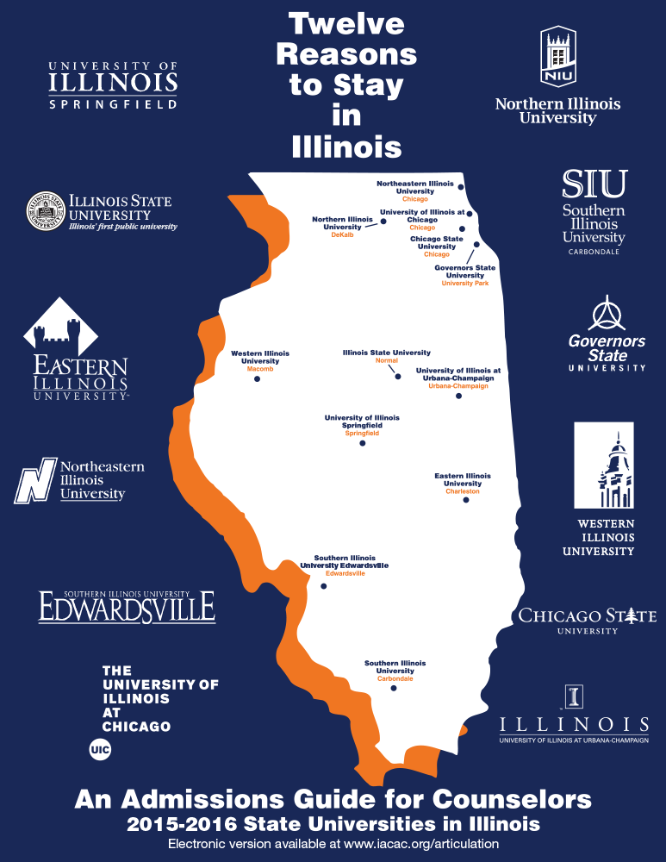
GovState Quick Facts
- Founded in 1969
- 4,427 Students Enrolled
- 12:1 Student-Faculty Ratio
- 49,000 alumni
- 42.6% of Undergraduates are First Generation College Students
- 25 countries represented in our student body

Slide 3
Find the right program for YOU!
College of Arts and Sciences
16 programs, 23 minors
College of Education and Human Development
3 programs, 3 minors
College of Business
5 programs, 8 minors
College of Health and Human Services
7 programs, 2 minors

Slide 4
What’s New @ GOVSTATE?
First Generation Center – opened in Fall 2023; support center focused on providing extra resources to succeed in their educational journey
Latinx Resource Center - opened in Spring 2024; serving Latinx students by supporting, appreciating and culturally representing on GovState’s campus
Social Justice Initiative (Legal Clinic) – opened Summer 2023; provides free self-help legal assistance and non-legal resources to low-income Illinois residents
Greek Life – Alpha Kappa Alpha Sorority, Incorporated was the first divine nine organization to cross on GovState campus in November 2023; more to come…

Slide 5
Get Involved!
Student Clubs and Organizations
Sports Teams
Student Senate
On-campus Employment
Honors Societies
Program Counsels
Student Ambassadors
Leadership Development

Slide 6
Benefits of being involved on campus
Practical Transferable Skills
- Event planning
- Delegating
- Leadership
- Fundraising
- Collaborating
- Marketing
Letters of Recommendation or References
The more you are involved the easier it is for people to advocate for and support you after college.

Slide 7
Become a Jaguar!
NAIA Collegiate Teams
-Men’s and Women’s Basketball
-Men’s and Women’s Cross Country & Track
-Men’s and Women’s Golf
-Men’s and Women’s Soccer
-Women’s Volleyball
-Women’s Bowling
Men’s Basketball
-2018 Conference Champions
-Conference Tournament Champions
-Earned 1st ever bid to NAIA National Tournament
Women’s Basketball
- Earned 1st ever bid to NAIA National Tournament

Slide 8
Admission Requirements
- 24 semester hours of college coursework
- 2.0+ cumulative GPA*
- Good standing at previously attended institution
*Education, Health Administration, and Social Work have special requirements.

Slide 9
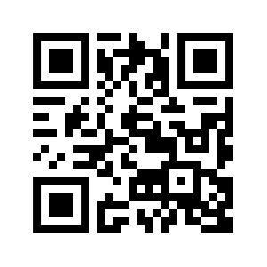
How to Apply
Complete an application today, or online at: apply.govst.edu/apply
You can also apply via the Common App (Freshman and Transfer)
$25 application fee – currently waived for Undergraduate Students!
Submit all Official Transcripts to: apotranscripts@govst.edu
Check for additional admission requirements
Examples: Social Work requires two Letters of Recommendation; Nursing requires RN Licensure.

Slide 10
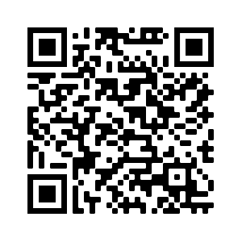
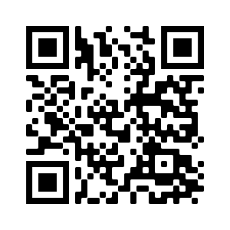
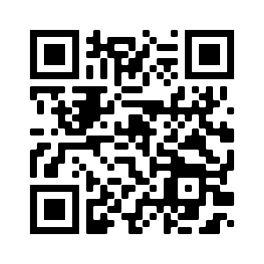
Transfer Student Resources
Jaguar Transfer Credit Evaluator
The Jaguar Transfer Credit Evaluator is a tool to help transfer students see how their previous college coursework and exams contribute to their degree at GovState! The process is quick, easy, and even provides next steps for transferring.
Transfer Guides
GovState has agreements with many area community colleges that help ensure the proper transfer of courses
Transfer Thursdays
During Transfer Thursday, you will have the opportunity to receive an on-the-spot admissions decision! You will first complete the online application prior to Transfer Thursday, then on the day of, you will come to GovState with all official transcripts from all previously attended institutions.

Slide 11
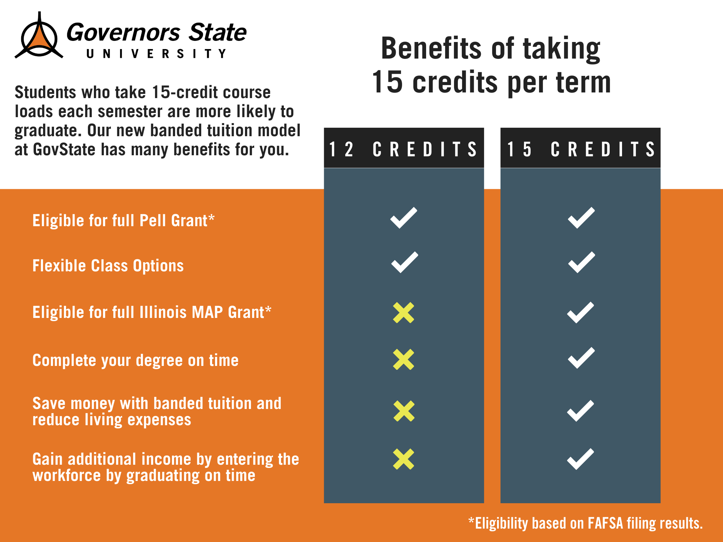
New for 24-25- Banded Tuition
All new students will be charged banded tuition starting in Fall 2024.
Allows students to be charged the same tuition if you are taking 12 credit hours or more!

Slide 12
Tuition and Fees
 | GSU Cost | Financial Aid Opportunities
Non- Residential Cost | $14,056 per year* ($56,224 Degree) | Max Pell Grant: $7,395 Max Illinois MAP Grant: $8,400 Potential Refund of $2,099 (Fall and Spring Combined)
Residential Cost (Tuition, fees, housing, and meal plan) | $22,160 ($88,640 Degree) | Remaining Cost: $6,100*

Slide 13
Office of Admissions
Phone: (708) 534-4490
Email: admission@govst.edu
Website: www.govst.edu/admissions

Slide 14
Ways to Connect to Admissions
Direct Line: 708-534-4490
Craig Berry:
cberry@govst.edu
708-534-4492
Bailie Antwiler:
bantwiler@govst.edu
708-235-6841
Direct Link: www.govst.edu/admissions/
Spanish Language Virtual Appointments Available

Slide 15
GovState Honors Program

Slide 16
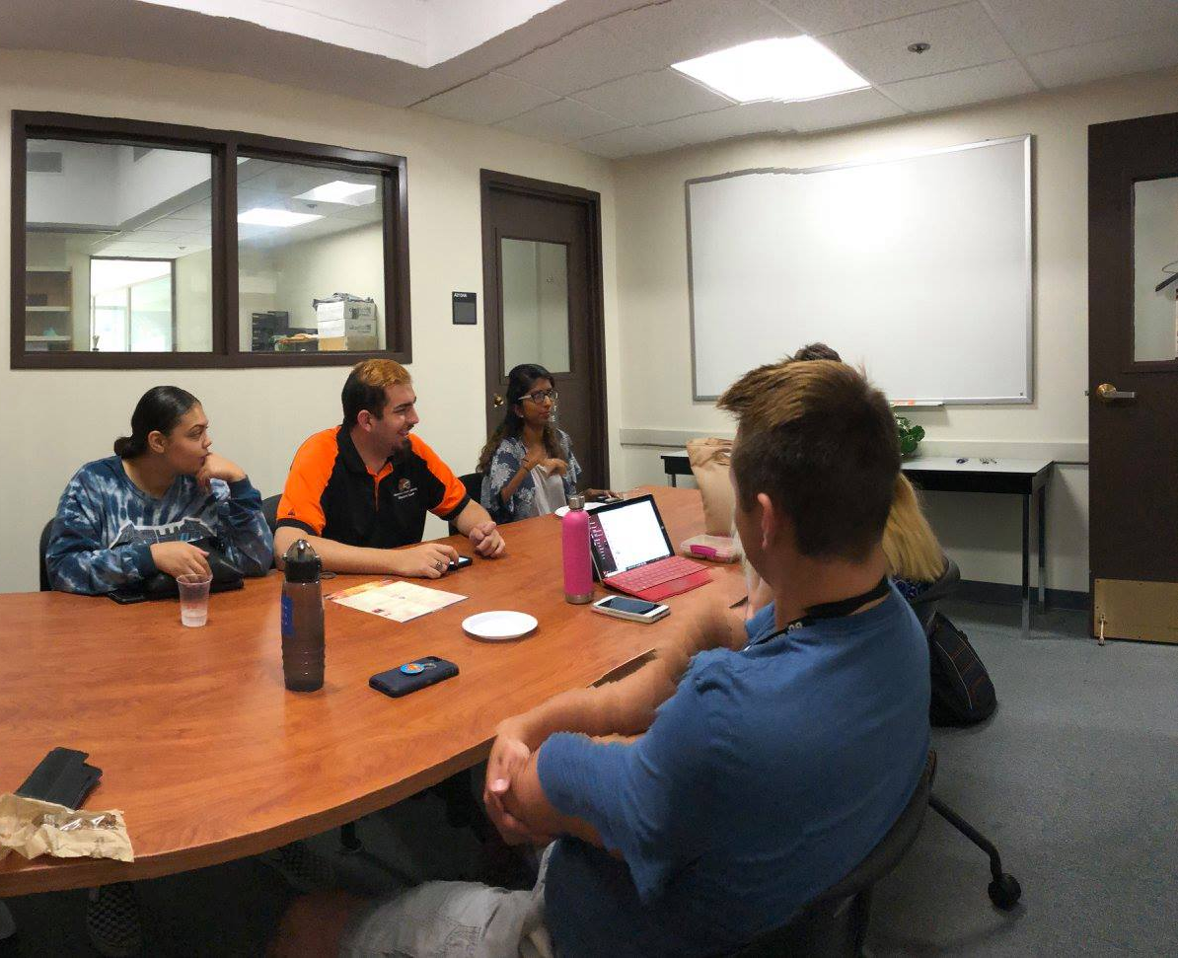
In-Class and Real-World
Honors Program Points
Curricular Activities
Courses
Independent Studies
Course Contracts
Double Majors/Minors
Co-Curricular Activities
Study Abroad
Undergraduate Research
Leadership Experiences

Slide 17
Graduate with Honors
Ready for life…Ready to lead
Honors Program Experiences
-Junior Capstone Experience
-Internship (career bound)
-Thesis (graduate school bound)
-Senior Leadership Experience

Slide 18
Dual Degree Program (DDP)
www.govst.edu/ddp

Slide 19
DDP Partner Community Colleges

Slide 20
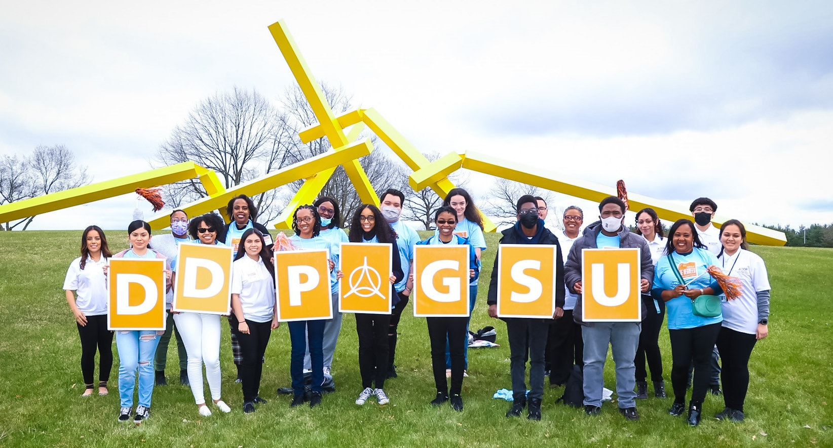
Why enroll in DDP?
The DDP is called "dual degree" because it assists you in the completion of your associate degree AND THEN enables you to transfer seamlessly to Governors State University to complete your bachelor's degree.
Students who are interested in participating in the Dual Degree Program are encouraged to join as early as possible while pursuing the associate degree at their community college.

Slide 21
Many Benefits of DDP
Personalized transfer guidance from DDP Transfer Specialist
Exclusive scholarship opportunities for DDP students
Locked-in GovState tuition rate at time of DDP enrollment
Guaranteed admission to GovState and application fee waived
Exceptions with special admissions requirements include Social Work, Nursing, Business and Applied Science (BAAS) & Manufacturing Management programs
Exclusive programming like DDP Induction and Cording Ceremonies
Participate in DDP social and community service events throughout community college and GovState experiences
Access to GovState student perks prior to transferring, such as access to the Fitness Center and Center for Performing Arts student discount

Slide 22
DDP Scholarships
GovState Promise Scholarship
Requires 2.75+ GPA, associate degree, and Pell eligibility at time of transfer
Tuition & Fees assistance for up to four semesters (fall/spring)
Undocumented students (who are eligible for in-state tuition) are encouraged to apply!
DDP Honors Scholarship
Requires 3.5+ GPA, associate degree, and membership in Phi Theta Kappa or CC Honors
Tuition & Fees assistance for up to four semesters (fall/spring)
Commitment to participating in the GovState Honors Program
Undocumented students (who are eligible for in-state tuition) are encouraged to apply!
DDP Chicago STAR Scholars Scholarship
Requires a 3.50+ GPA, and must be a current participant in the Chicago STAR Scholars program at the City Colleges of Chicago
Option #1: $500 book/campus dining award for up to four semesters
Option #2: Campus housing contract (semi-suite) for up to two years
Undocumented students (who are eligible for in-state tuition) are encouraged to apply!

Slide 23
Eligibility Requirements
Currently attending one of our 17 partner community colleges
In good academic standing (2.0+) at current community college
Intention of completing an associate degree prior to transferring
To remain in DDP while attending community college:
Maintain 2.0+ GPA and continuous enrollment through transfer
Meet with DDP Transfer Specialist each semester at CC
Graduate an associate degree and transfer that next spring/fall!

Slide 24
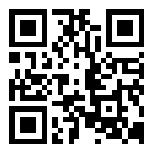
Contact DDP today!
www.govst.edu/ddp
Alexandro Venegas City Colleges of Chicago (all seven campuses)
avenegas2@govst.edu ꟾ 708.235.7537 ꟾ GovState Office: A2122
Juan Gonzalez College of DuPage, Harper College, Joliet Junior College, Moraine Valley Community College, Morton College, Triton College & Waubonsee Community College
jgonzalez11@govst.edu ꟾ 708.235.7534 ꟾ GovState Office: A2122
Sharita Walker Kankakee Community College, Prairie State College & South Suburban College
swalker3@govst.edu ꟾ 708.235.7536 ꟾ GovState Office: A2122
Jessica Specht Director of DDP jspecht@govst.edu ꟾ 708.534.4494 ꟾ GovState Office: A2128

Slide 25
FINANCIAL AID FOR
TRANSFER STUDENTS

Slide 26
Financing Your Education

Slide 27
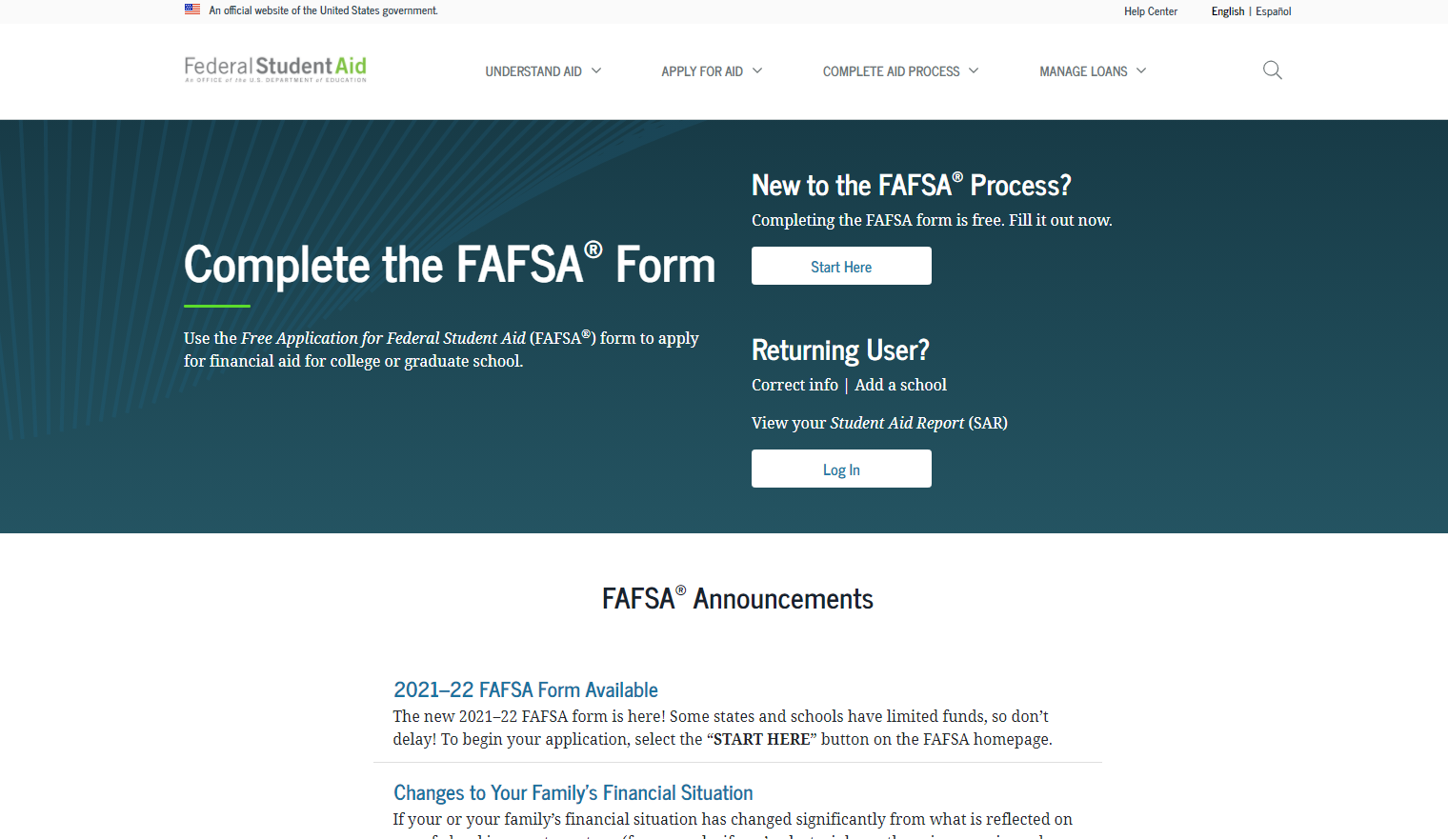
How Do I Apply for Financial Aid?
Have you done the #FAFSA?
Free Application for Federal Student Aid
Found online at studentaid.gov
Direct Link: (https://studentaid.gov/h/apply-for-aid/fafsa)
Update for 24/25 FAFSA

Slide 28
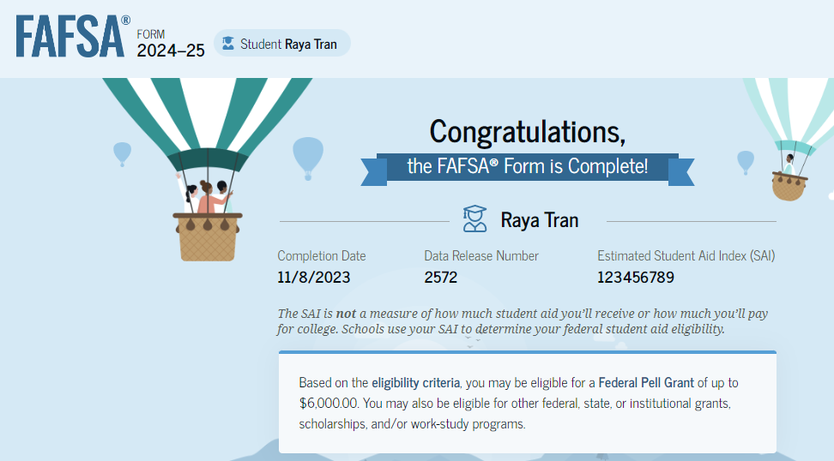
FAFSA Processing Results
Student will receive a ‘FAFSA Submission Summary’ via email
Record will be sent to colleges student listed on FAFSA about one week after FAFSA is
submitted
Colleges may request
additional information
after FAFSA received
Corrections can be made;
be wary of corrections!
Too many can lead to verification.

Slide 29
Cost of Attendance
Direct Costs- Paid directly to school
Tuition, fees, room and board, meal plans, etc.
Indirect Costs- Variable fees that depend on personal circumstances/choices. These costs can vary widely.
Transportation, personal expenses, books and supplies, off-campus housing, etc.
COA is not what you will pay out of pocket; consider it a comprehensive budget that helps you plan for all potential expenses associated with your education.

Slide 30
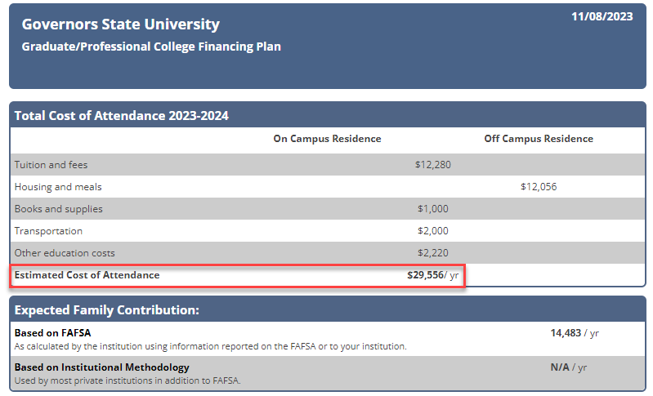
Example Cost of Attendance
However, I only took 6 classes for the year, so my out-of-pocket tuition and fees were actually $8,856.

Slide 31
Types of Financial Aid
1. Grants
2. Loans
3. Scholarships
4. Student Employment Opportunities

Slide 32
Types of Grants (2023-2024 Award Amounts)
Federal PELL Grant
Up to $7,395, determined by SAI
Illinois MAP Grant
Up to $8,400, determined by SAI
Federal SEOG Grant
$1,000 for students with
exceptional need
TEACH Grant
Pays up to $3,772 p/year
Requires 3.25 GPA
After graduation 4-year work requirement

Slide 33
Student Loans
1. Federal Direct Loans*
-Subsidized
-Unsubsidized
-Parent PLUS
2. Private Student Loans
*Students must be enrolled in at least half-time (6 credit hours) status with Financial Aid eligible coursework to qualify for Federal loans.

Slide 34
Dependent Direct Loan Borrowing Limits
Grade Level | Amount
Junior/Senior Year | $5,500 Subsidized; $2,000 Unsubsidized
Aggregate Loan Limits | $31K- $23K Sub, $8K Unsub
Independent Direct Loan Borrowing Limits
Once you become an independent student, which happens at age 24, or if you become married, have a child, or are a veteran, your unsubsidized loan aggregate limit increases from $8,000, as shown above, to $34,500. The subsidized limit stays the same at $31,000.
This makes your independent aggregate loan limit: $57,500 ($23,000 subsidized, $34,500 unsubsidized)
Notes:
Define difference between subsidized and unsubsidized loans
Mention there are annual loan limits (freshman year sub is $3.5K/sophomore year sub is $4.5K, etc)
Mention we offer plus loans but those are meant to bridge the gap, if a student is leaning toward one, please come talk to our office first or visit scholarship universe. Plus loans offer a higher interest rate, similar to a private loan.

Slide 35
Parent Plus Loan
A parent-plus loan is a federal student loan taken out in the parent's name. The parent is ultimately responsible for repaying the loan.
While this is better than pursuing a private loan, we recommend looking into scholarships or payment plans before going this route, as PPLs carry higher interest rates similar to those of private loans.
There aren’t aggregate limits to PPL’s and can be issued up to cost-of-attendance. Meaning if you take our COA and deduct what financial aid you are set to receive (grants, loans, scholarships, federal work-study, etc.,), that can be your total PPL amount.
If you apply and are denied, you can request an endorser, or your child can receive additional unsubsidized loan money.
Notes:
Define difference between subsidized and unsubsidized loans
Mention there are annual loan limits (freshman year sub is $3.5K/sophomore year sub is $4.5K, etc)
Mention we offer plus loans but those are meant to bridge the gap, if a student is leaning toward one, please come talk to our office first or visit scholarship universe. Plus loans offer a higher interest rate, similar to a private loan.

Slide 36
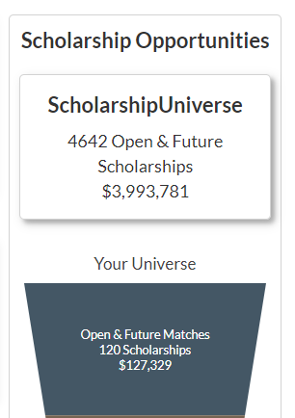
Scholarships
GovState Scholarship homepage: www.govst.edu/Scholarships/
Scholarship Universe: www.govst.scholarshipuniverse.com/public
With Scholarship Universe, Students will be able to:
Answer questions and match to scholarship opportunities they are eligible for
The more you answer, the more scholarships you match to
Easily apply online to multiple scholarship opportunities through a personalized portal
See scholarship metrics to determine their chances and effort required to apply
Be alerted whenever they are matched to new scholarship opportunities
GovState and external scholarships
All vetted = no questioning if the scholarship is legit

Slide 37
Federal Work Study
Allows students to earn money to help pay for educational expenses
Employment on or off-campus
Minimum wage or higher
Gain valuable work experience
Great networking experience
FAFSA is required
https://www.govst.edu/work-study/ https://www.govst.edu/employment-resources
Notes:
FWS is a government allotment to work on campus up to the amount on their award letter
All jobs pay $15 an hour or more
These are typically assistant-type roles (answering phones, emails, etc)
I always mention during down-time they can typically get their HW done
Gain work experience and get to explore different areas within the university
Talk about that’s how you got your job here ☺

Slide 38
Financial Aid Link “F.A. Link”
Students can use the funds left over after their tuition/fees are covered in the bookstore- online and in-person
You must remain F.A. eligible to use the funds in the bookstore-
If you make any purchases at the bookstore with your F.A. Link and then adjust
your schedule, you may end up owing money
Using FA Link is a voluntary service that is not required
Term | FA Link Opens and Closes
SPRING 2024 | 11/20/2023 – 2/2/2024
SUMMER 2024 | 4/16/2024 – 5/31/2024

Slide 39
AIM HIGH – Transfer Students
Guaranteed Transfer Scholarships for up to $5000 per year
No application necessary!
Must have earned an associates degree at a community college or transfer from another 4-year institution.
Renewable for 4 semesters.
Full criteria available online based on your entry term
govst.edu/aimhigh-transfer/

Slide 40
Office of Financial Aid
Phone: (708) 534-4480
Email: faid@govst.edu
Website: www.govst.edu/financialaid

Slide 41
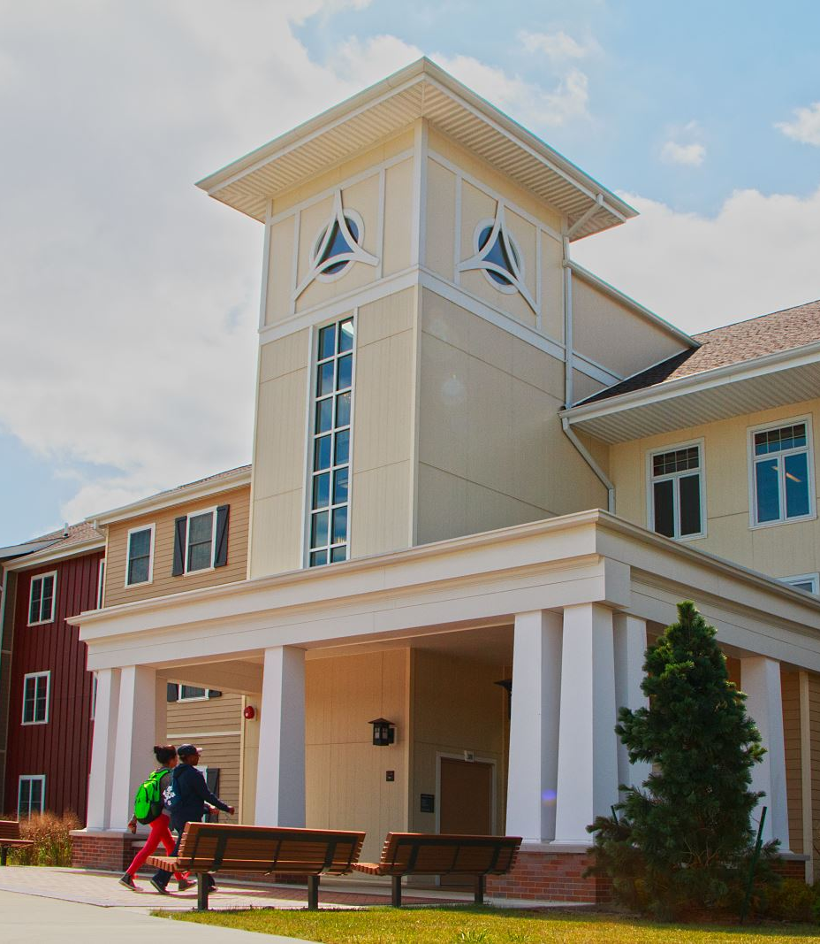
BREAKOUT SESSIONS Housing
Engbretson Hall
Campus Resources
Hall of Honors
Life on Campus (Student Life)
Sherman Hall

